Slide 1
Identification of Regulatory Binding Sites Using Minimum Spanning Trees
Pacific Symposium on Biocomputing, pp. 327-338, 2003
Reporter: Chu-Ting Tseng
Advisor: Prof. Chang-Biau Yang
Date: Apr. 2, 2004

Slide 2
Outline
Introduction
Minimum Spanning Tree (MST)
Binding Site Identification by MST
Distance Scoring Function
Position-specific Information Content
Applications

Slide 3
Introduction
Computationally, the binding-site identification problem is often defined as to find short ”conserved” fragments, from a set of genomic sequences, which cover many (or all) of the provided genomic sequences.

Slide 4
Minimum spanning trees (MST)
It may be defined on Euclidean space points or on a graph.
G = (V, E): weighted connected undirected graph
Spanning tree : S = (V, T), T ⊆ E, undirected tree
Minimum spanning tree(MST) : a spanning tree with the smallest total weight.

Slide 5
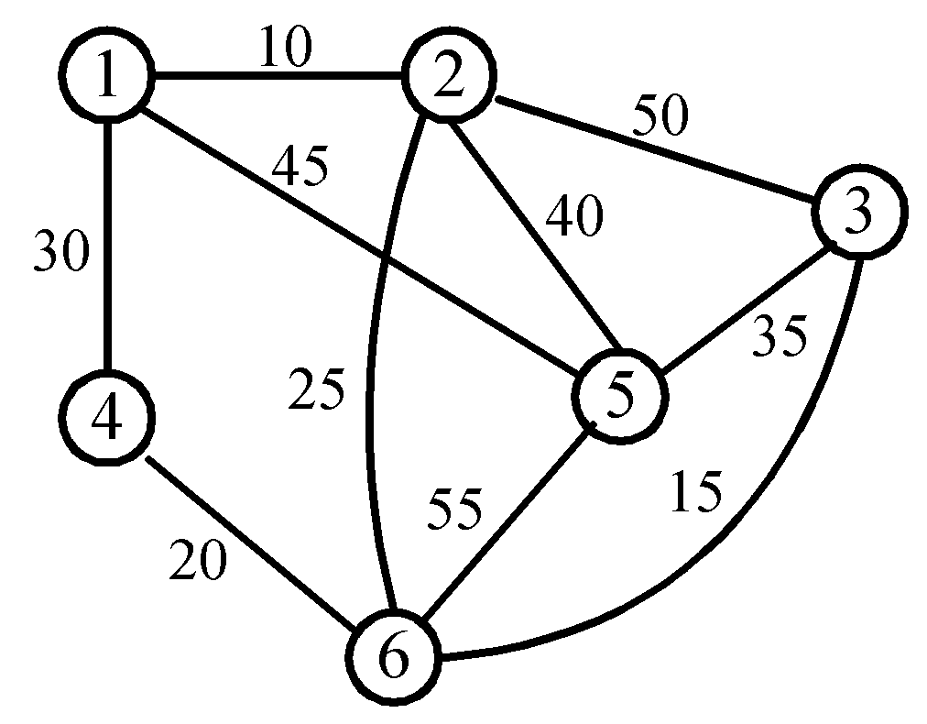
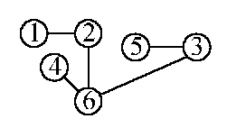
An example of MST
A graph and one of its minimum costs spanning tree (sum=105)

Slide 6
Prim’s algorithm for finding MST
Step 1: x ∈ V, Let A = {x}, B = V - {x}.
Step 2: Select (u, v) ∈ E, u ∈ A, v ∈ B such that (u, v) has the smallest weight between A and B.
Step 3: Put (u, v) in the tree. A = A ∪ {v}, B = B - {v}
Step 4: If B = ∅, stop; otherwise, go to Step 2.
(see the example on the next page)

Slide 7
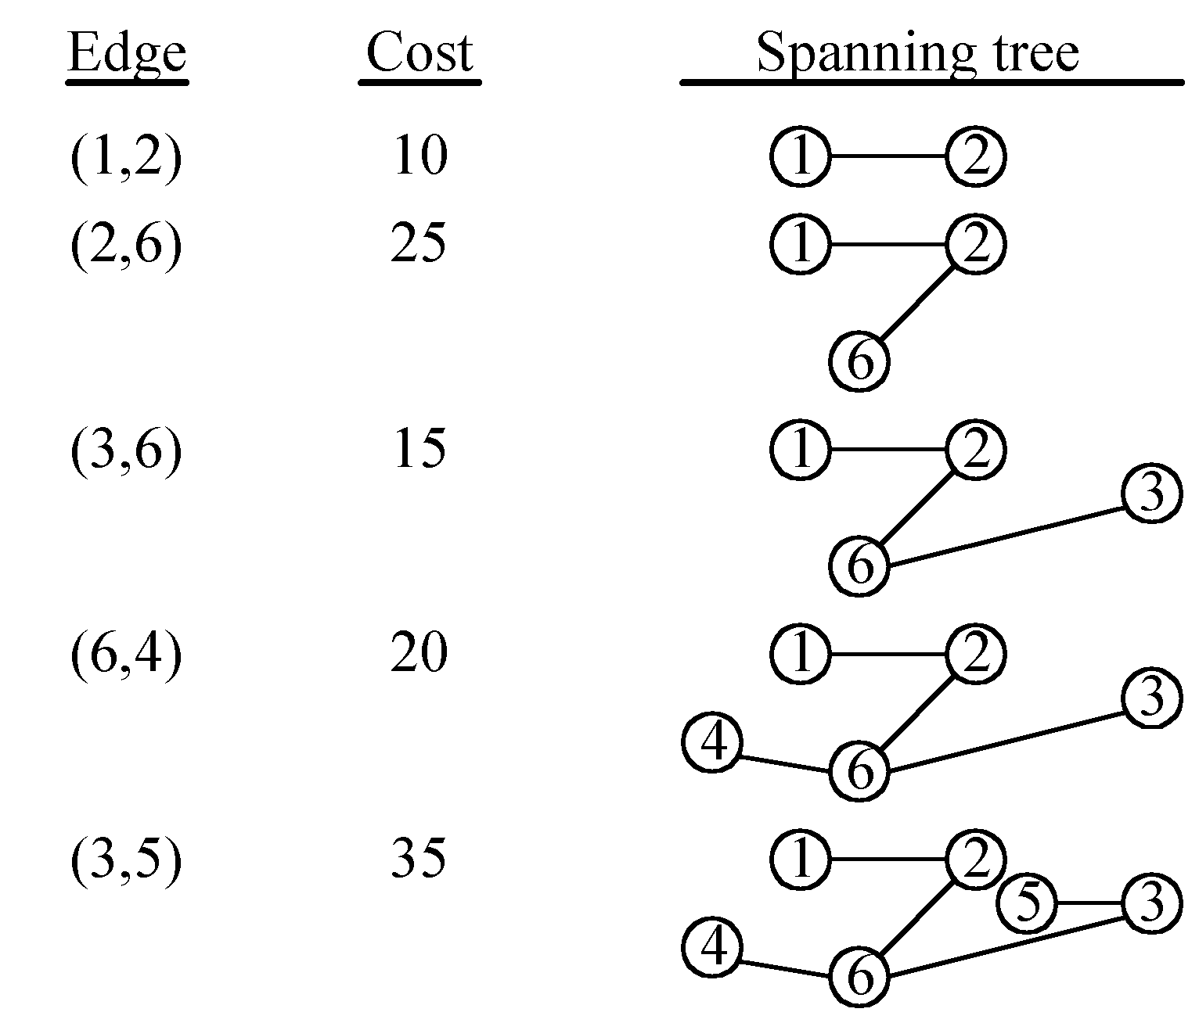
An example for Prim’s algorithm

Slide 8
Binding Site Finding by MST (1)
Conceptually, we map all the fragments, collected from the provided genomic sequences, into a space so that similar fragments (on the sequence level) are mapped to nearby positions and dissimilar fragments to far away positions.

Slide 9
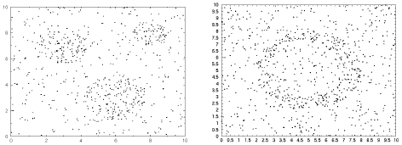
An Example of Mapping

Slide 10
Binding Site Finding by MST (2)
Because of the relatively high frequency of the conserved binding sites appearing in the targeted genomic sequence regions, a group of such sites should form a “dense” cluster in a sparsely-distributed background.
If C is a cluster in D, then C’s data points form a subtree of the MST of D.

Slide 11
Binding Site Finding by MST (3)
If we plot the edge distance in the selection order by the Prim’s algorithm, with x-axis be the linear representation L(D) of D, and the y-axis represents the distance of the corresponding MST edge. Each cluster should form a “valley” in this plot.
A substring S of L(D) represents a cluster if and only if (a) S’s elements form a subtree, T_{S}, of D’s MST, and (b) S’s both boundary edges have larger distances than any edge-distance of T_{S}.

Slide 12
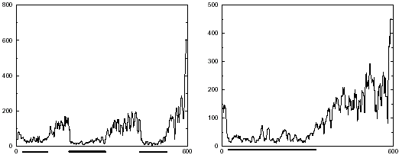
Edge-distance Plot Example

Slide 13
Binding Site Finding by MST (4)
For every substring of L(D) check whether it’s a cluster, it can be done linear time of the number of vertices.
Total time: O(||D||³)

Slide 14
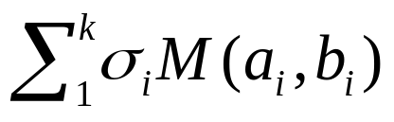
Distance Scoring Function
For two k-mers A = a₁…a_{k} , B = b₁…b_{k} ∊ S, we define their distance
ρ(A,B) =
where M(x, y) = 0 if x = y otherwise 1. Initially, all σ_{i} is set to 1/K, where K is the number of sequences containing at least one of the k-mers A or B.

Slide 15
Method
Break the sequences into k-mers
Calculate the distance between each pair.
Apply the ClusterIdentification procedure to identify all clusters.

Slide 16
Conditions for a Cluster to Be a Binding Site
The position-specific information content of the gapless multiple-sequence alignment, among all the sequence fragments represented by a cluster, should be relatively high.
Elements of an identified cluster should not be among long, simple repeats
The data density within a cluster should be relatively higher than the one of the overall background.

Slide 17
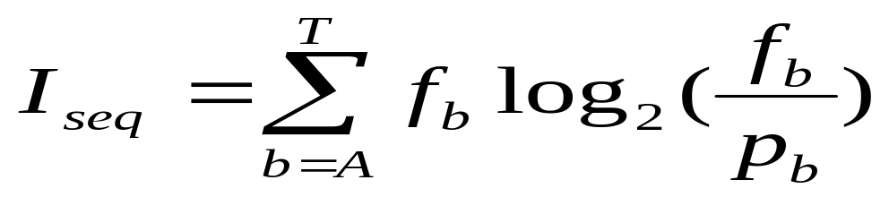
Position-Specific Information Content
where f_{b} is the observed frequency of each base in the collection of sites and P_{b} is the fraction of each base in the genome.

Slide 18
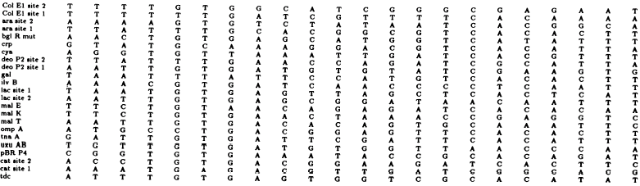
An Example of PSIC (1)

Slide 19
An Example of PSIC (2)
f_{b}
A | 11/23=0.48 | 0.48 | 0.39
C | 1/23=0.04 | 0.00 | 0.13
G | 2/23=0.09 | 0.13 | 0.13
T | 9/23=0.39 | 0.39 | 0.35
log₂(f_{b} / p_{b})
A | 0.94 | 0.94 | 0.64
C | -2.64 | -2.75 | -0.94
G | -1.47 | -0.94 | -0.94
T | 0.64 | 0.64 | 0.49

Slide 20
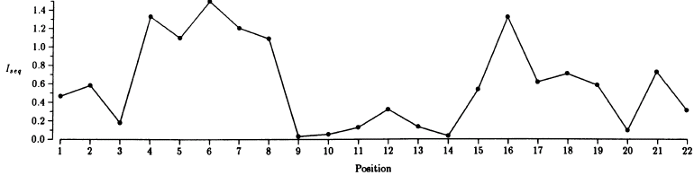
An Example of PSIC (3)

Slide 21
Scoring Function using PSIC (1)
After a cluster is identified, we will measure the position specific information content. If the overall information content is lower than some threshold, we will discard this cluster for further consideration.
Otherwise…

Slide 22
Scoring Function using PSIC (2)
For each position i, we use its information content as σ_{i} in the next iteration.
Set M(a_{i}, b_{i}) = 2 - (p_{i}(a_{i}) + p_{i}(b_{i})) + |p_{i}(a_{i}) -p_{i}(b_{i})|, where p_{i}(x) represents the frequency of letter x among all letters in position i.

Slide 23
Applications-- CRP (1)
CRP: Cyclic AMP receptor protein
CRP binding Sites: 18 sequences, each of length 105 bps, with 23 experimentally verified CRP binding sites (22-mers).
The only cluster identified consists of 24 fragments, of which 20 are known CRP sites.

Slide 24
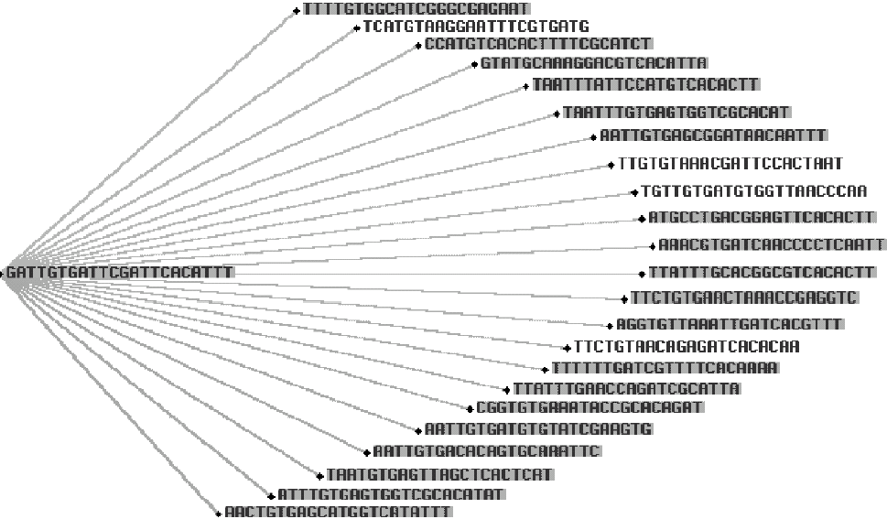
Applications-- CRP (2)

Slide 25
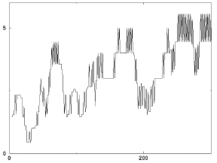
Applications-- CRP (3)

Slide 26
Applications-- Yeast (1)
Yeast binding Sites: There are 8 regulatory sequences, each containing 1000 bp.
By using 9-mers, our method identified several clusters. The most populated cluster is TTACCACCG.

Slide 27
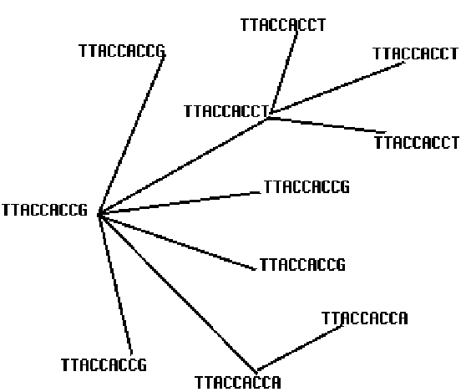
Applications-- Yeast (2)

Slide 28
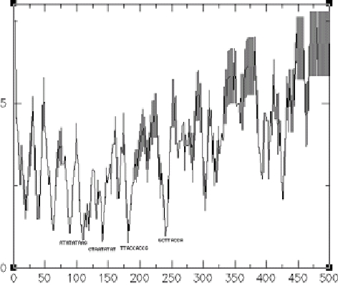
Applications-- Yeast (3)

Slide 29
Applications-- Human (1)
Human binding Sites:113 regulatory sequences containing regulatory regions. Each sequence is 300 bp long, with 250 bp upstream and 50 bp downstream of the transcriptional start site.

Slide 30
Applications-- Human (2)
The GCAGCC motif with at most one mismatch appears in 96 regulatory sequences, even more frequently than the TATAAA motif, where appears in 66 regulatory sequences with at most one mismatch.

Slide 31
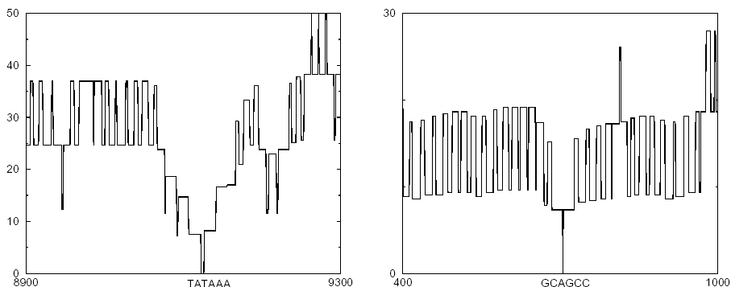
Applications-- Human (3)

Slide 32
Reference
Stormo, G. D. and Hartzell III, G. W. “Identifying protein-binding sites from unaligned DNA fragments.” Proceedings of the National Academy of Sciences USA, Vol. 86, pp. 1183-1187, 1989.

Slide 33
END

